Slide 1
Tiny Machine Learning

Slide 2
Topics
TPUs and Datacentres
Embedded Systems
ML and Embedded systems?
Definition
Challenges
Floating-Point Representation
Quantization mapping
Quantization Error
Quantized weight compression
Quantized inference
Dynamic and Static Quantization
Quantized Layers
Post-training Quantization
Quantization-aware training
Pruning
Knowledge distillation

Slide 3
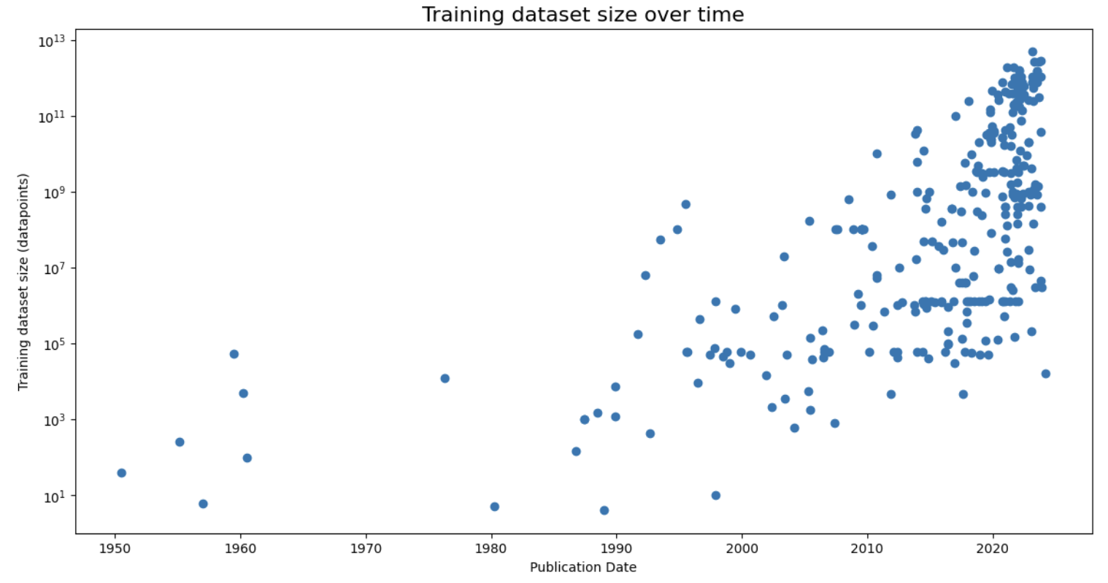
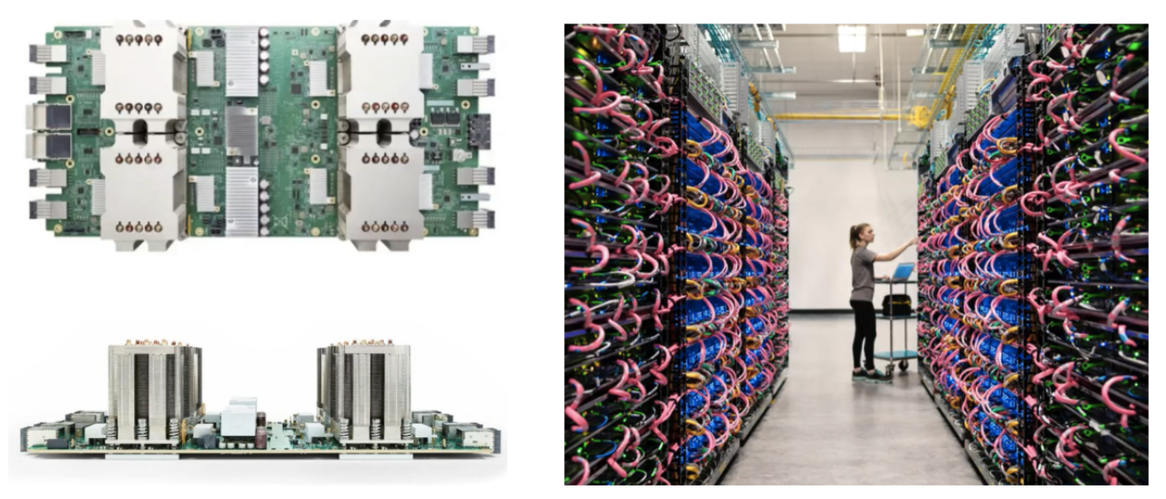
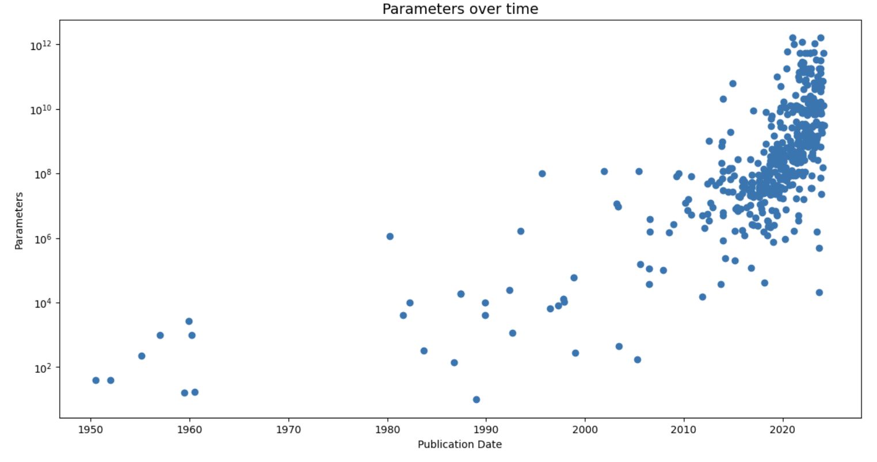
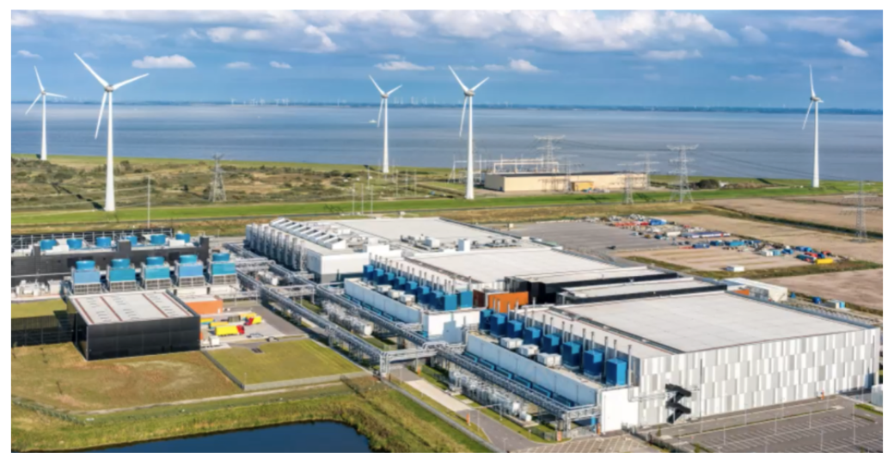
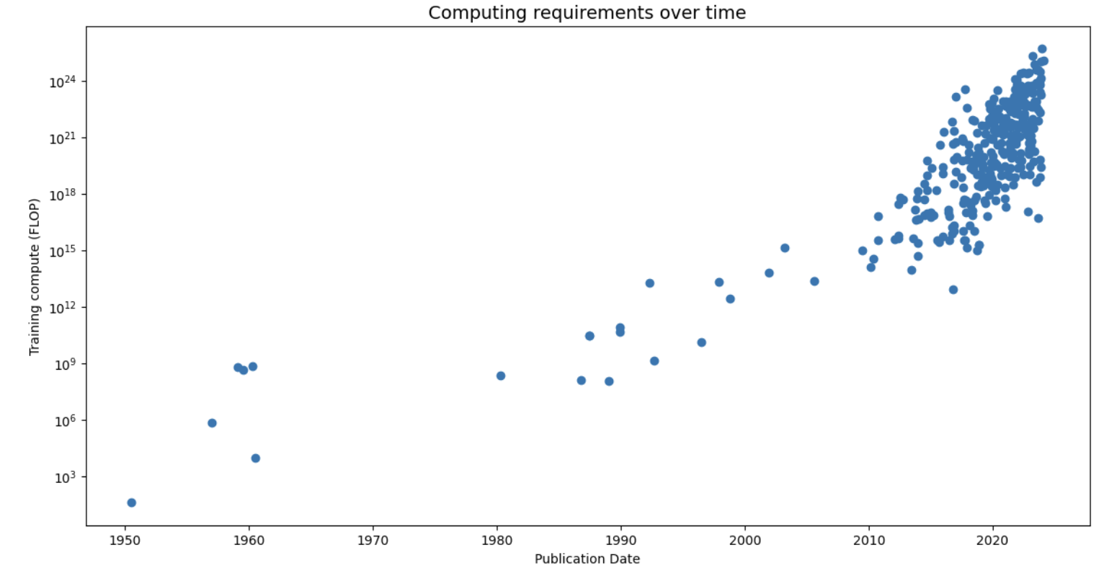
TPUs and Datacentres

Slide 4
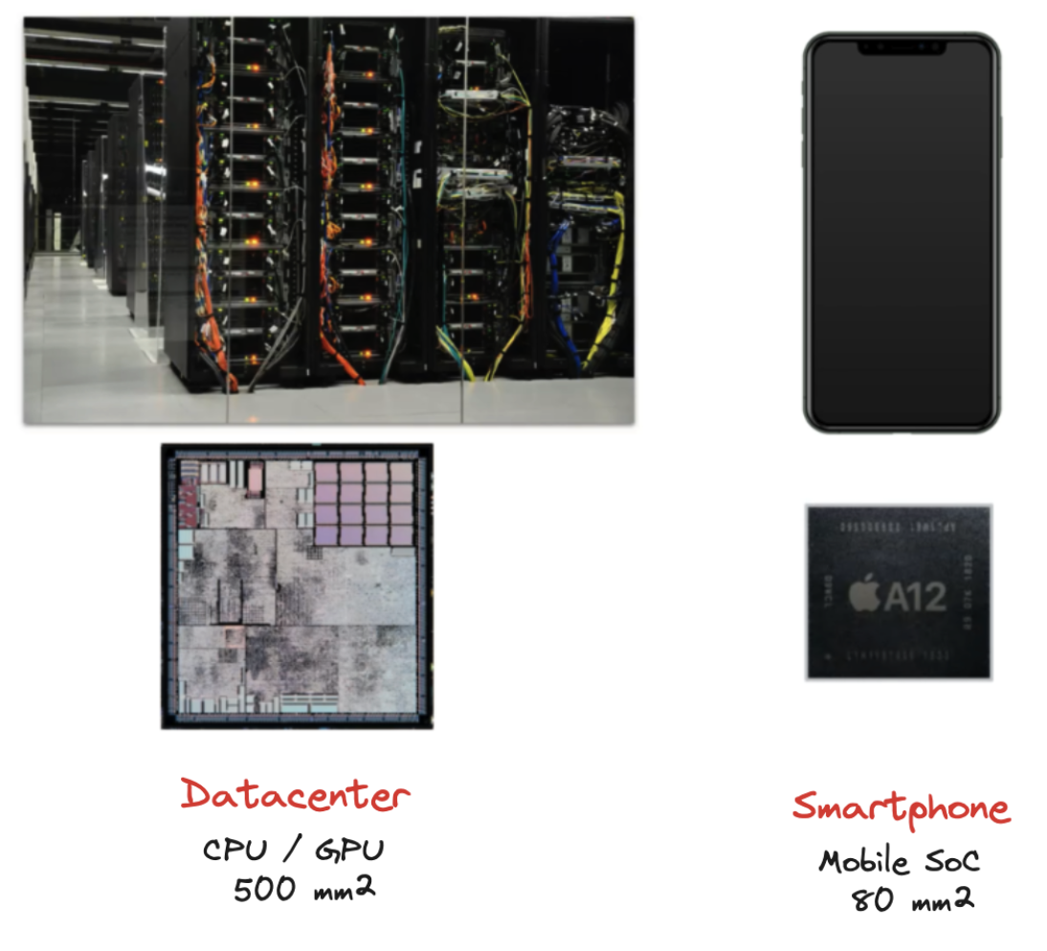
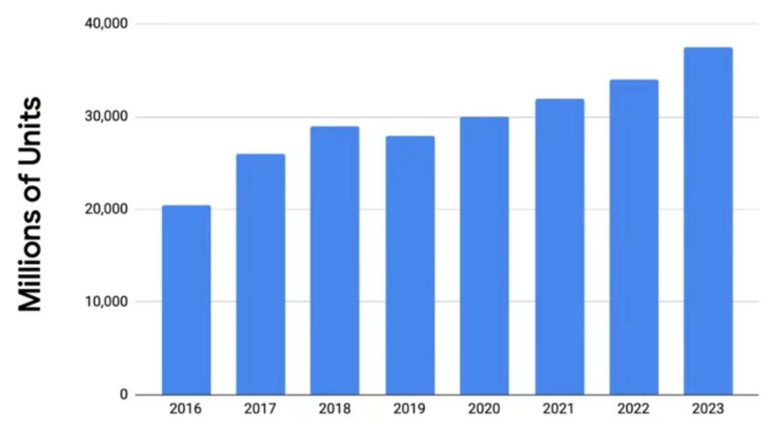
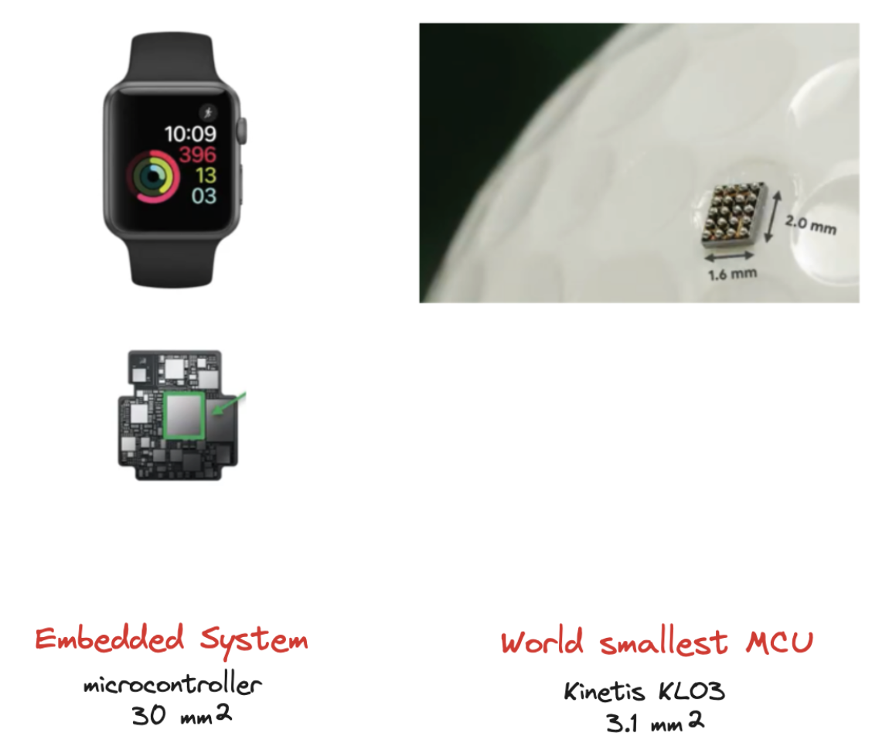
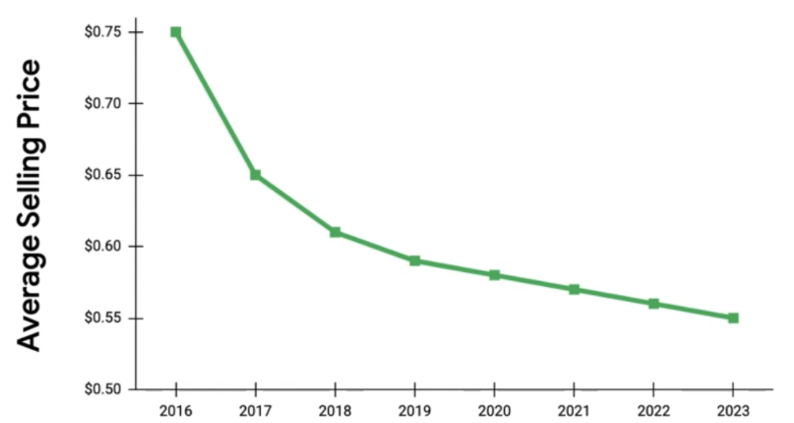
Embedded Systems

Slide 5
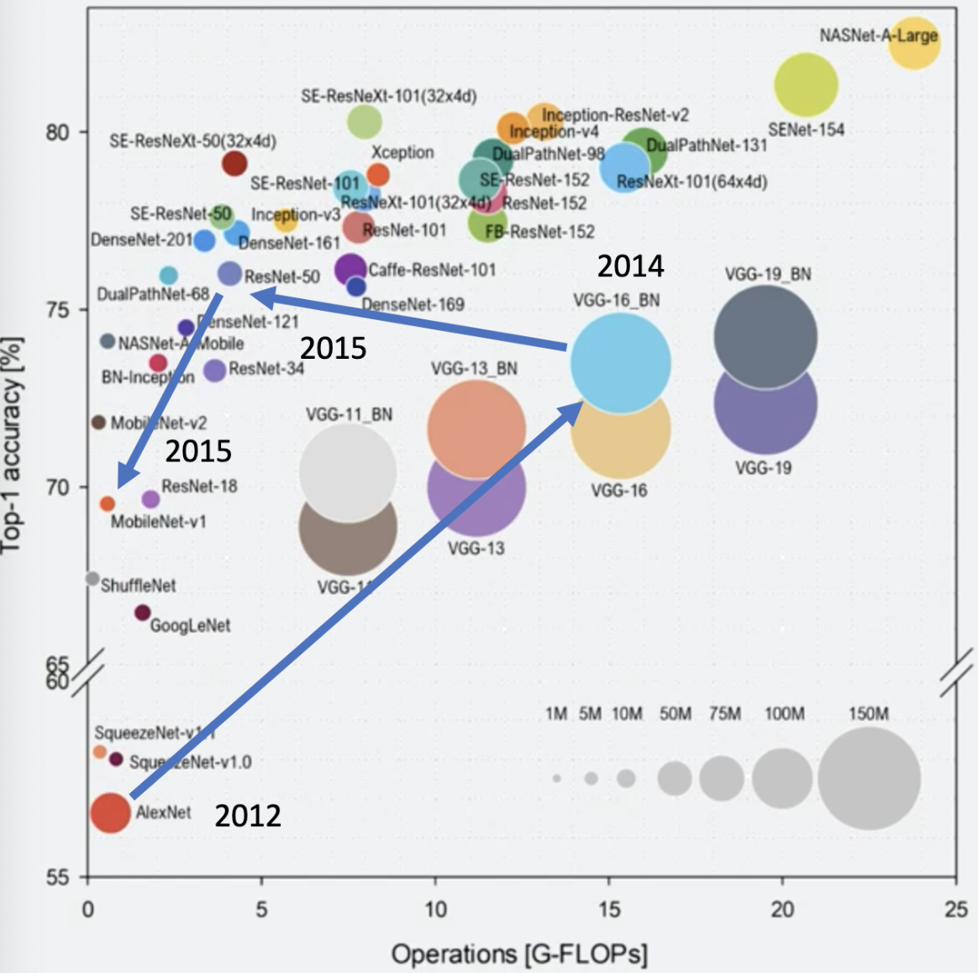
ML and Embedded systems?

Slide 6
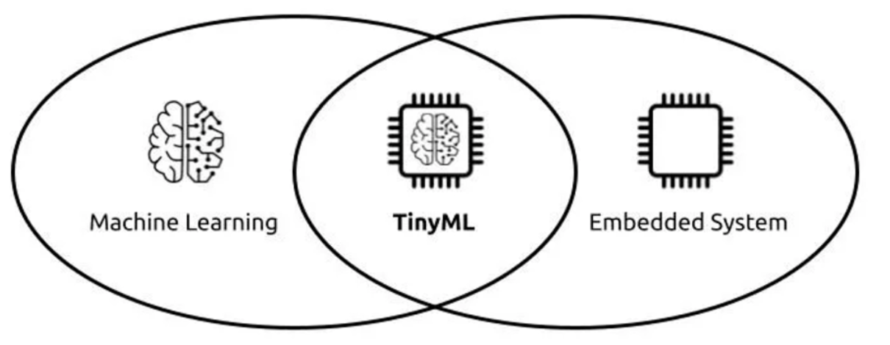

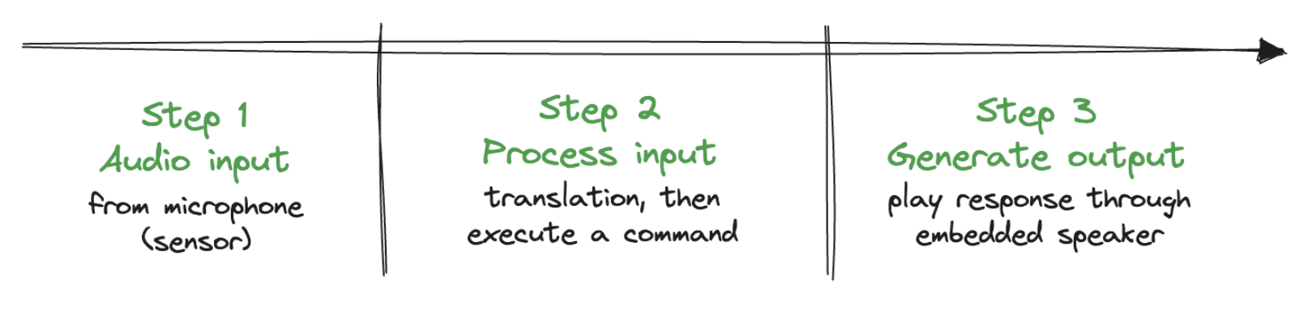
Definition

Slide 7
Challenges
Devices
limited memory
low computation power
Models
huge memory requirements
to store the input data, weight parameters and activations of the network
massive amount of computations
required for the calculation of the weighted sums of the neuron inputs
ML models are typically trained using 32-bit floating-point data
fp arithmetic is very expensive (area, performance, energy) to implement in hardware
32 bits of precision is needed during training to capture very small gradient steps
it is usually unnecessary during inference

Slide 8
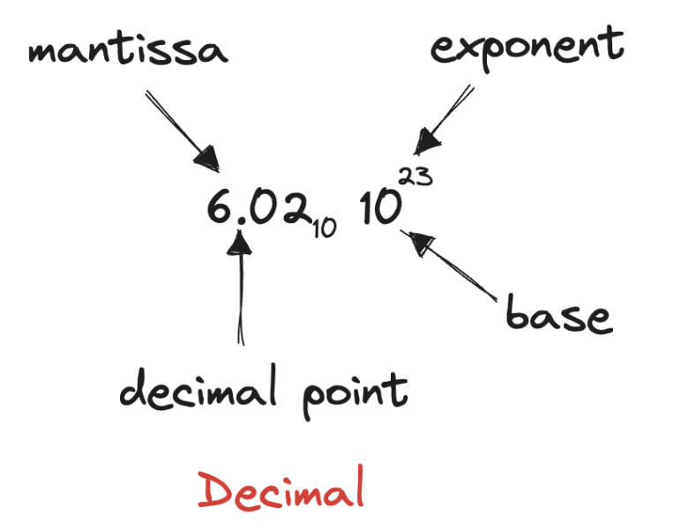
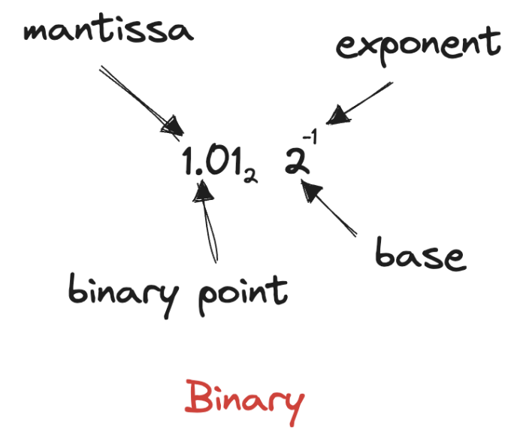
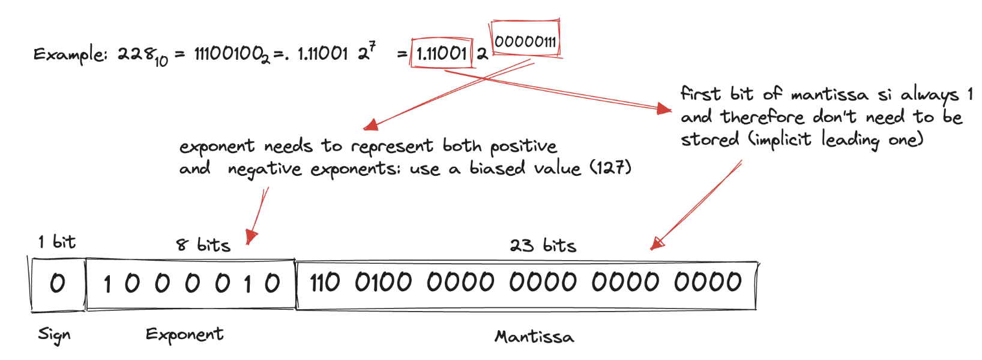
Floating-Point Representation
Analogous to scientific notation
have a sign, mantissa (M), base (B), and exponent (E)
allowing the representation of very large and very small number
IEEE 754 floating-point standard (FP32)

Slide 9
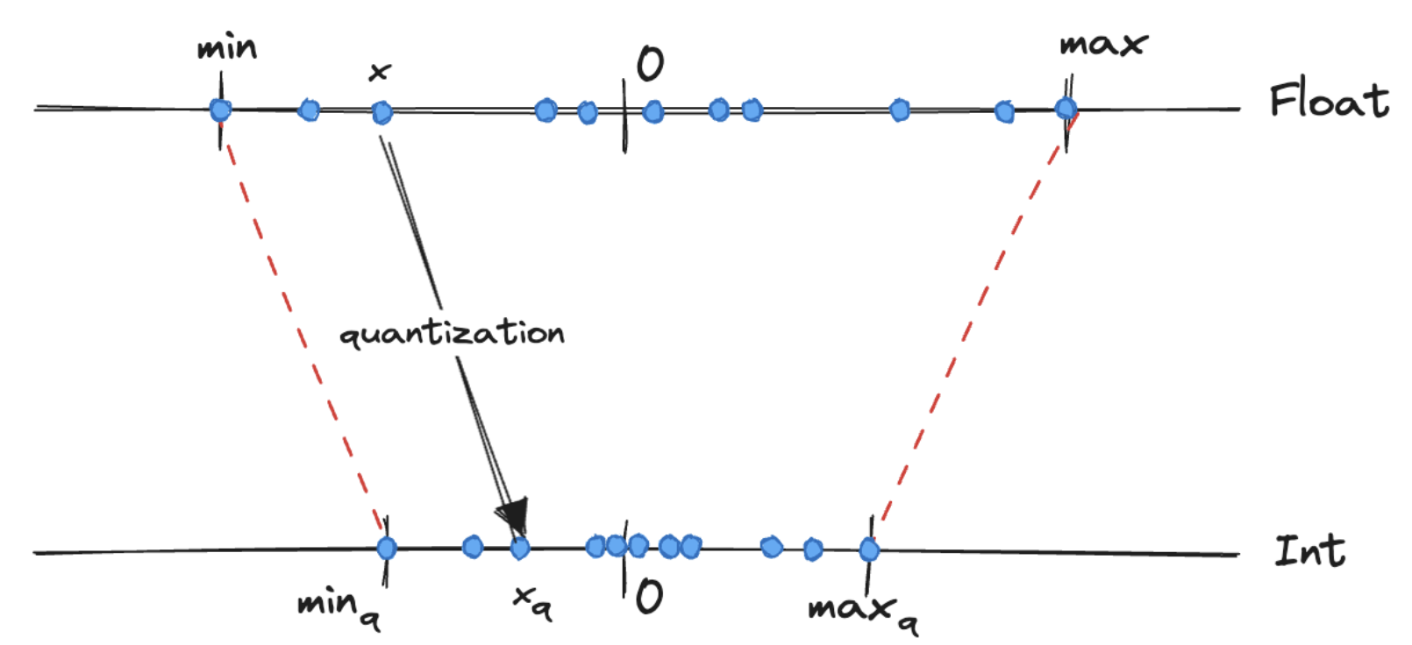
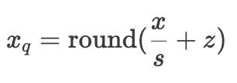
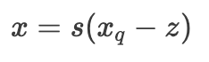
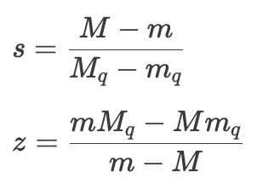
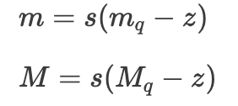
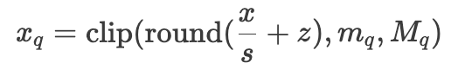
Quantization mapping
Mapping a floating-point value 𝑥 ∈ [m, M] to a b-bit integer 𝑥_{𝑞} ∈ [m_{𝑞}, M_{𝑞}]
Parameters s (scale) and z (zero point) can be derived to assure the mapping between the extreme values:
In practice, some values can be outside the range, we need to clip:

Slide 10

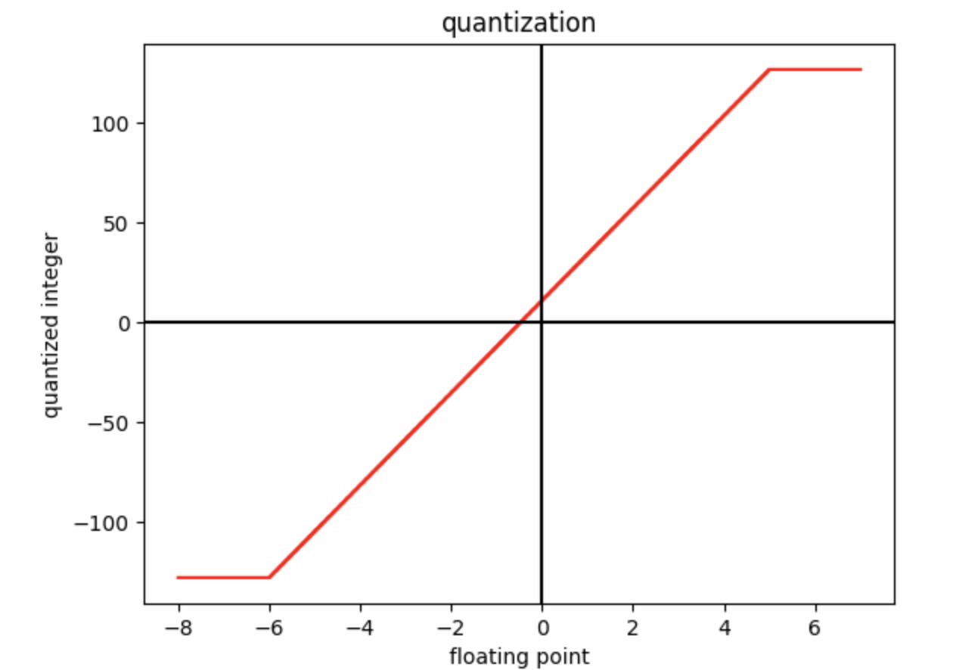
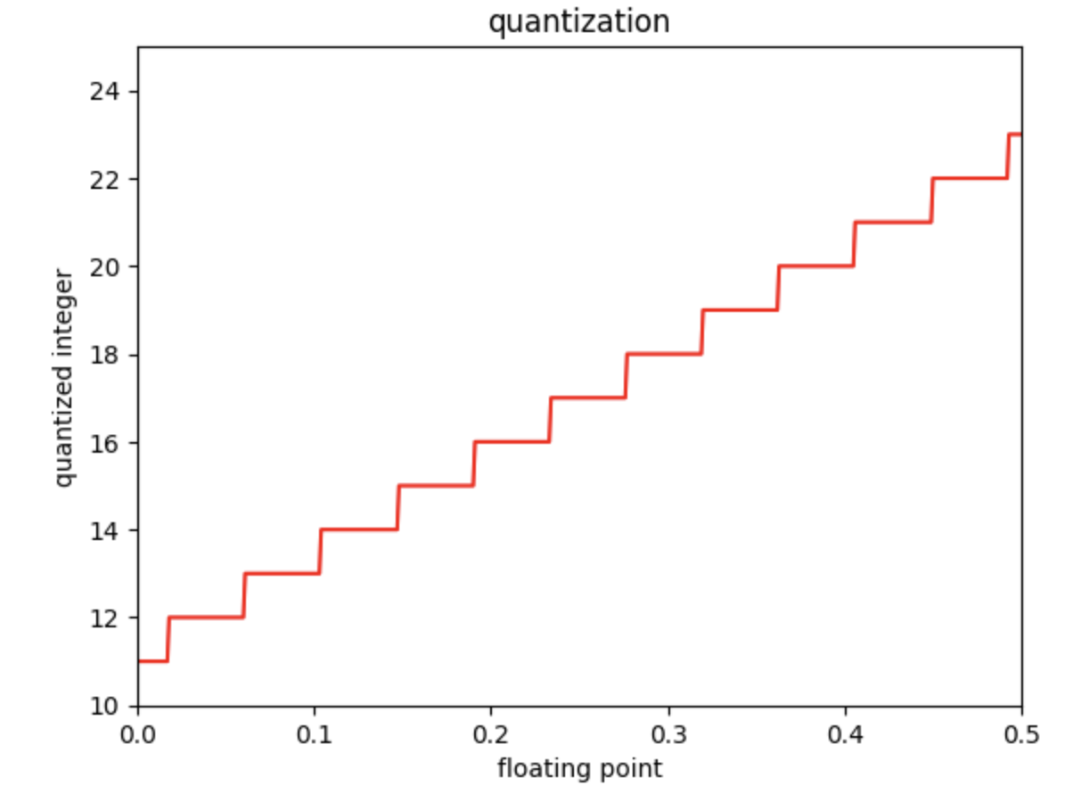
Quantization error
Quantization is not perfect
When we reconstruct the original value from the quantized one, we can see that there is a difference, which is called quantization error

Slide 11
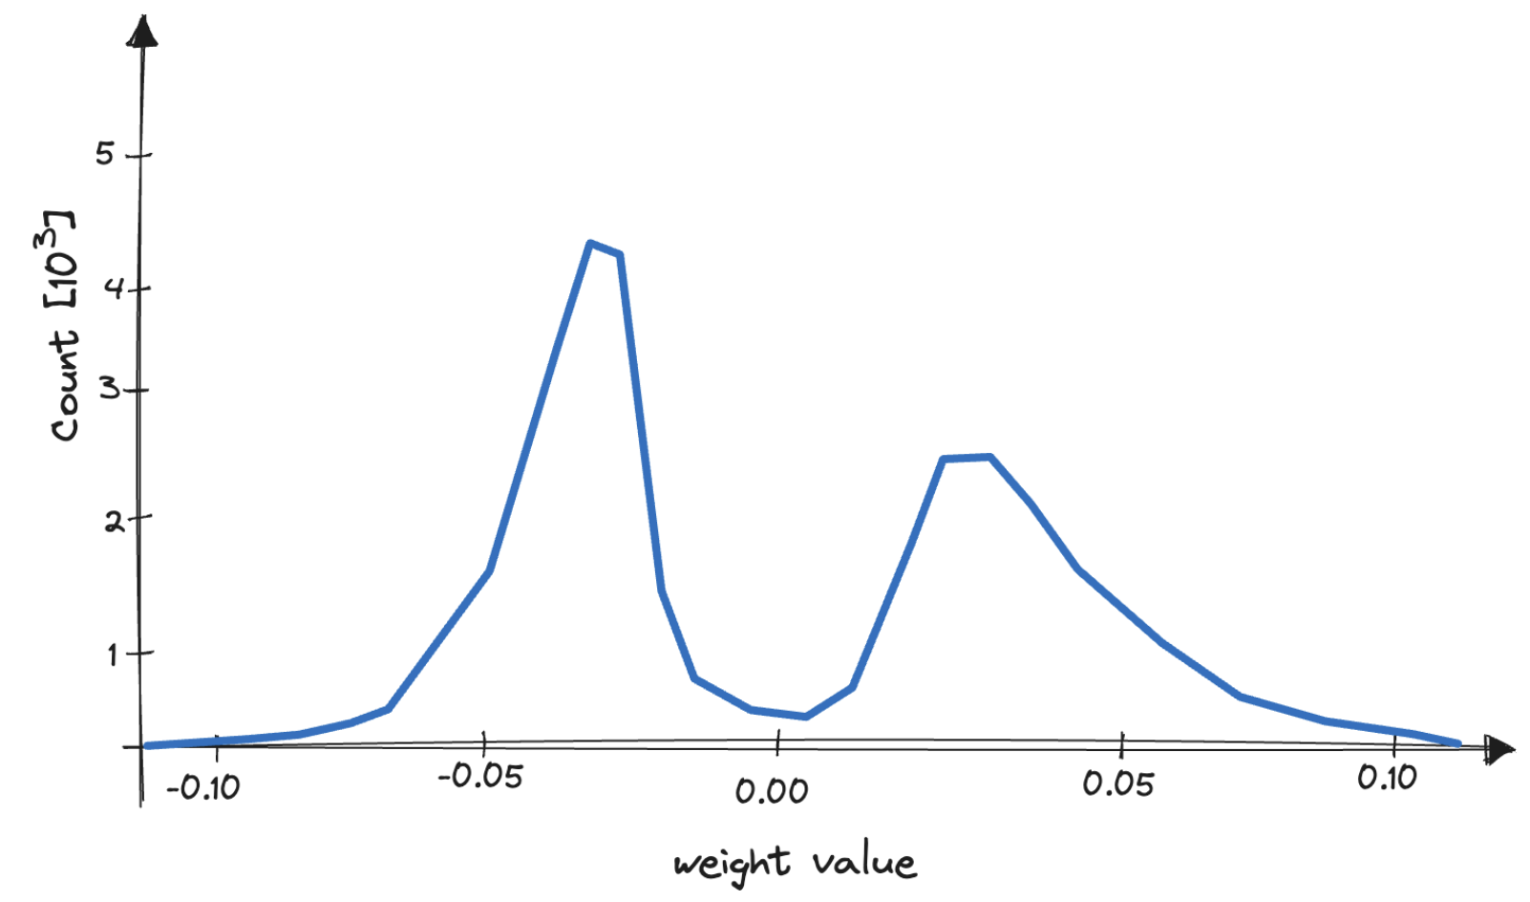
Quantized weight compression (1)
We can apply quantization to a model weights because they play a major role in terms of storage
We can observer, from experimentation, that the weight values tend to be very concentrated around certain critical ranges. Example from AlexNet:
We can quantize weights without losing the general representation of that space

Slide 12
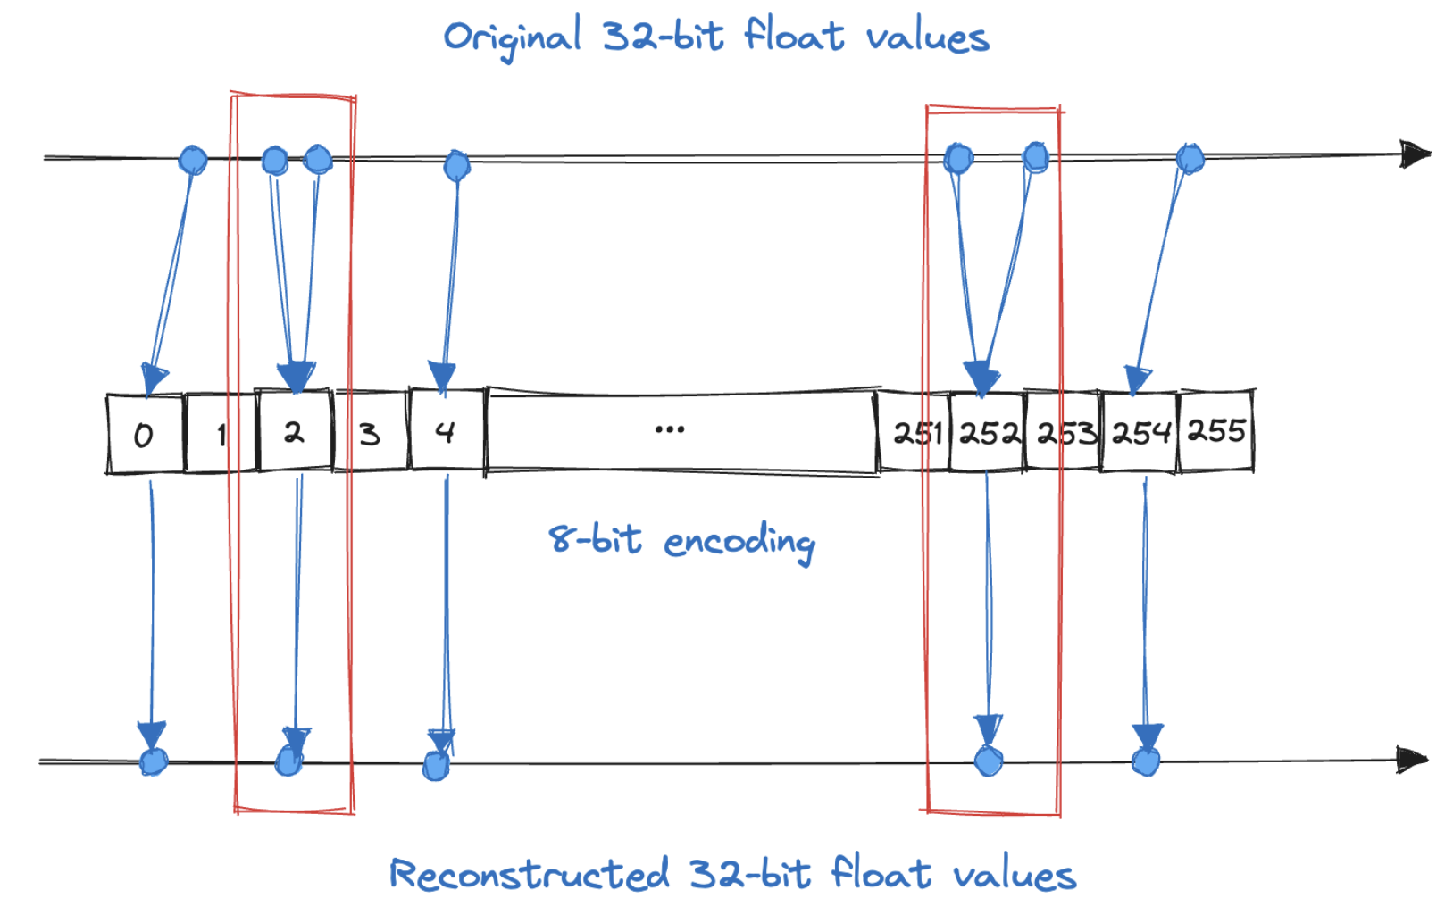
Quantized weight compression (2)
we save the floating-point values of weights into an 8-bit encoding scheme
When we run inference, we reconstruct them into a 32-bit floating point value
We obtain a model size reduction by 4x
Side effects, we lost some resolution

Slide 13
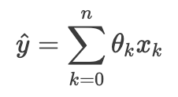
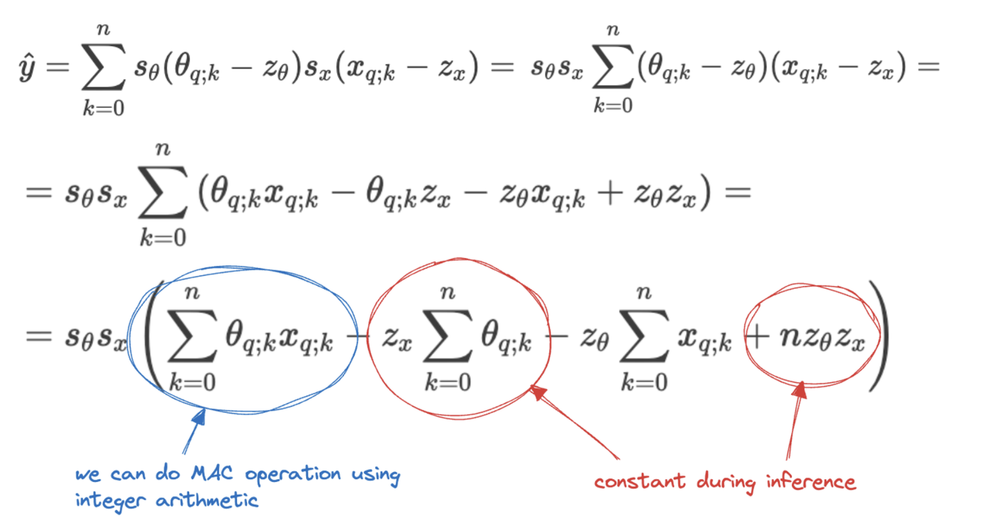
Quantized inference (1)
We can also in speed up the inference doing operations with integer arithmetic. Consider the output of a neuron with n features:
n multiplications and additions (MAC) to compute this single entry
given m samples and q neurons, we need to do a total of m * q * n operations
We can execute the operation using the quantized values of sample and weights:
We can quantize weights without losing the general representation of that space

Slide 14
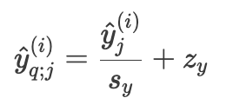
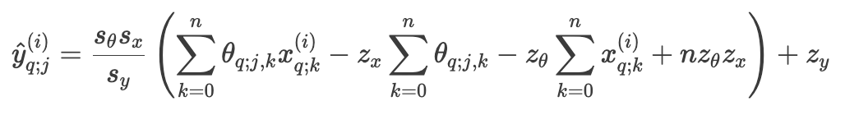
Quantized inference (2)
Floating-point arithmetic in silicon is slower than integer arithmetic
one/two vs ten or more cycles
reducing a model using integer values gives also an improvement in performance
space for designing special hardware accelerators
However, the output of a neuron becomes the input of another neuron, so we need to quantize this value before inputting it to the next layer
We need to consider that the range of the output of a neuron is unknown
scale and zero point for weights an be calculated before the inference, because their ranges are already available.
how can we calculate scale and zero point for activations?

Slide 15
Dynamic and Static Quantization
Dynamic quantization:
scale and zero point are calculated on-the-fly (online during inference) and are specific for each forward pass
activations are always stored in float, and they are converted to integers while processing and back to floating point after the processing is done
Static quantization
pre-computes scales and zero points also for all the activations to eliminate this overhead
we need some representative data to collect the distribution statistics for all the activation of each neuron and compute an esteem of scales and zero points

Slide 16
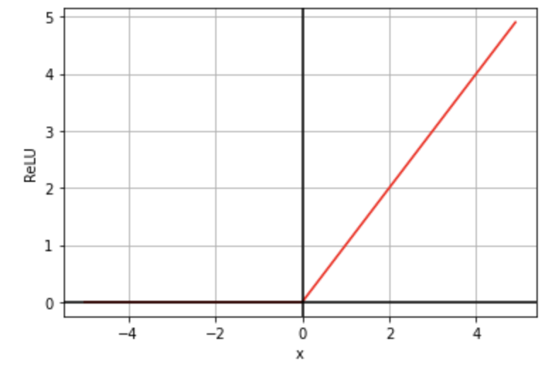
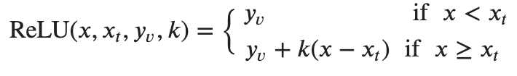
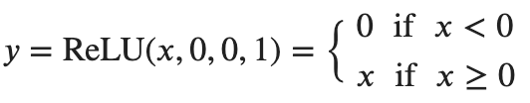
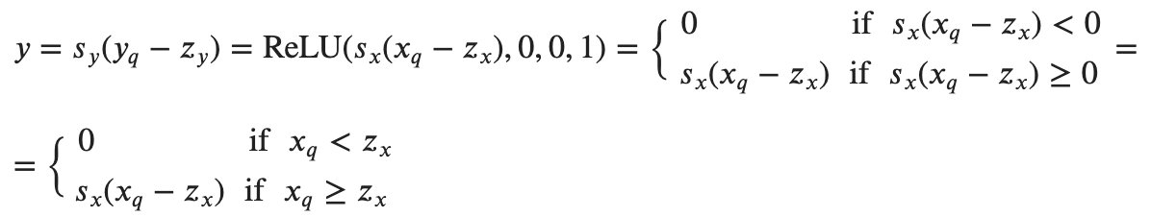
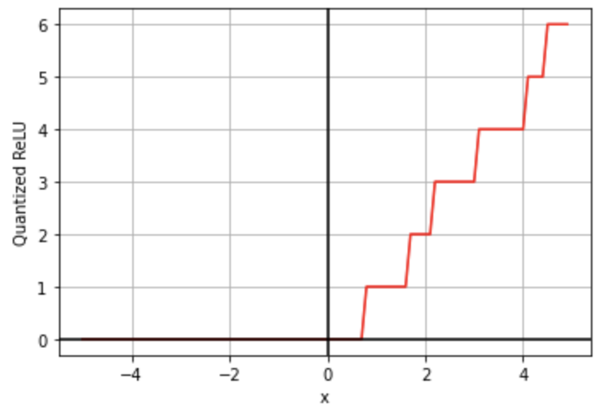
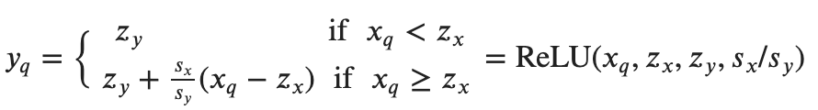
Quantized Layers
How do we deal with special layers (e.g. non-linear activation layers) in a quantized DNN?
Consider the ReLU activation function
general form:
common ReLU: 𝑥_{𝑡}=0, 𝑦_{𝑣}=0, 𝑘=1
Let’s derive the quantized ReLU mathematically:
Therefore:

Slide 17
Post-training Quantization
Quantization performed on already trained models
without developing a new model architecture
start with an existing FP model and quantize it to obtain a fixed-point quantized model
without needing to re-train
Several benefit:
generally model size reduction is a factor of 4
less working memory needed (due to the reduction on the precision of data)
faster processing of 8-bit data (most processors)
lower power consumption (due to the reduction in the data movement)
All the factors above translate into faster inference
typical speedup of 2-3x due to the reduced precision for both memory accesses and computations
The cost is usually modest decrease in accuracy

Slide 18
Tensor Flow Lite
Set of tools to run TF models on mobile, embedded, and IoT devices
on-device machine learning inference
many techniques for optimization, including quantization
TFLite Converter to generate a FlatBuffer representation
efficient cross-platform serialization format
allows access to the serialized data without parsing or unpacking
we can ask it to apply dynamic range post-training quantization
in general models can be made four times smaller with a two to three time speed-up
TFlite Interpreter to run the model and make inferences.
provided for most common mobile/embedded platforms
to run models on microcontrollers locally with minimum memory requirements
without any OS support or other high-level language libraries dependencies

Slide 19
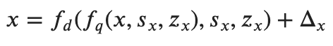
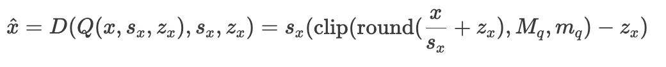
Quantization Aware Training
Quantization introduces information loss
floating point numbers are not exactly recoverable
inference accuracies are inevitably lower
The idea is to ask the neural networks to take the effect of such information loss into account during training
we add a quantization and a de-quantization layer for each of the tensors
scale and zero point could be collected like in static quantization
We have injected the quantization error into the training pipeline
network naturally learns how to cope with this source of error.
Quantization-aware training is not guaranteed to always be able to do better
Sometimes it does even better that the original floating-point network!

Slide 20
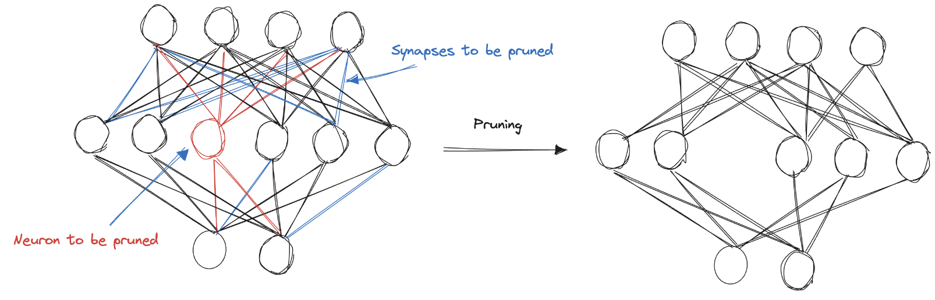
Pruning
Neural networks are usually over-parameterized
significant redundancy in the number of required neurons
unnecessary computation and memory usage at inference time.
Selective removal of certain parts: less important neural network connections and nodes
The objective is to make a model smaller, improve its inference time, while maintaining a good accuracy/performance.

Slide 21
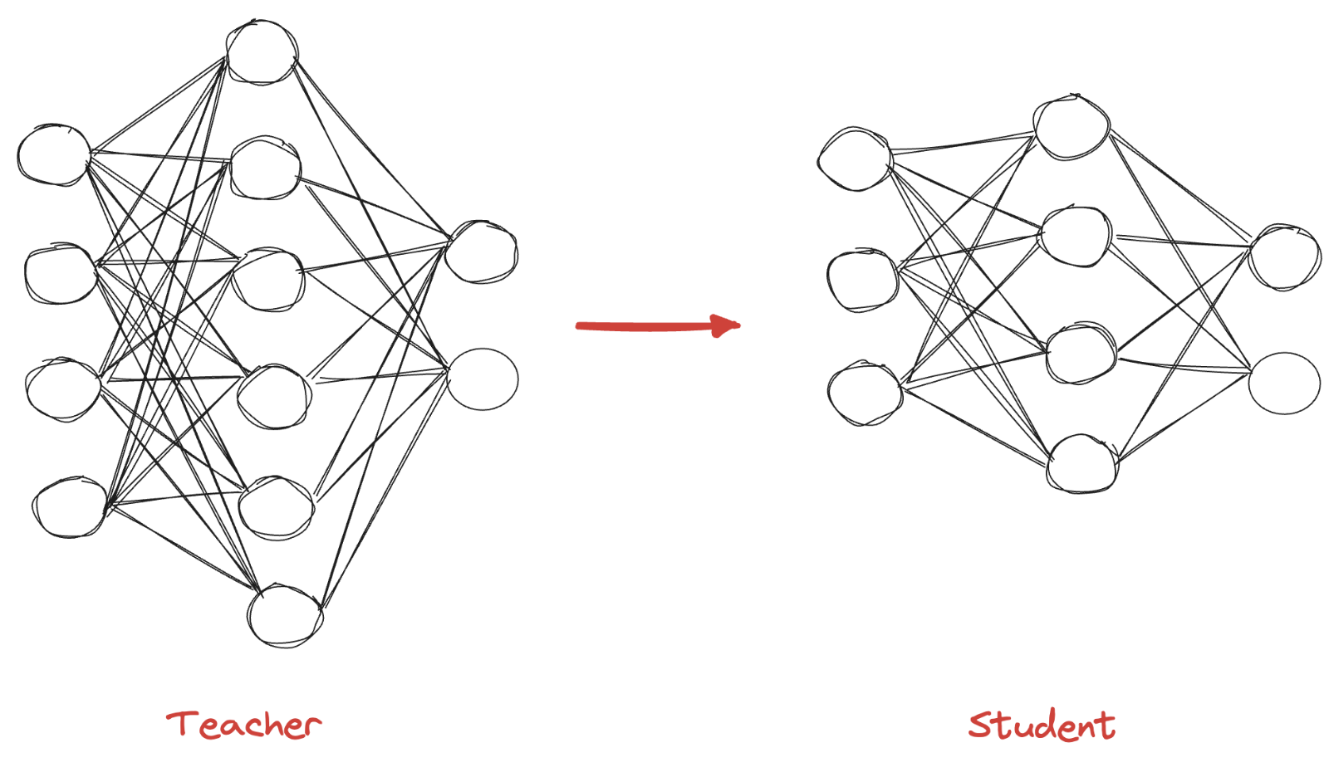
Knowledge distillation
An already trained complex and high performing model is used to govern a smaller model on what to do and how to do a particular task, without losing accuracy.
This is like a teacher transferring his knowledge to a student in a school
The student has no prior experience in executing the task, however he executes it with the knowledge imparted by the teacher in handling similar situations.
Similarly, through knowledge distillation, smaller models are trained using the knowledge acquired by a large model:

Slide 22
Exercise
1 - Add some dense layers to the pre-trained MobileNetV2 model, then fine-tune it over the cats vs dogs image classification problem using transfer learning. Then apply post-quantization optimizations and check difference in size and performances

